Slide 1
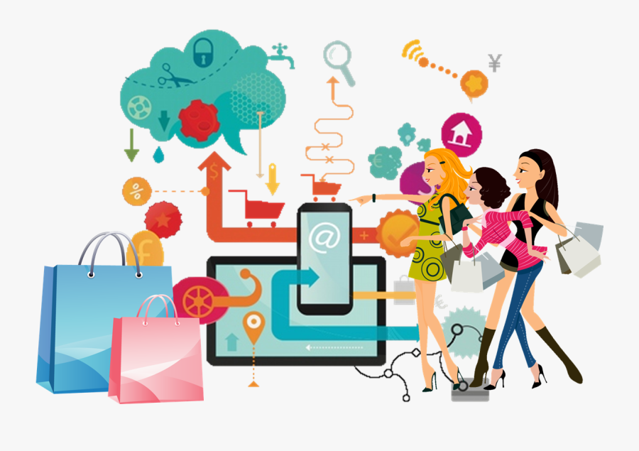
CONSUMER BEHAVIOUR IN CLOTHING CHOICES AND IMPLICATIONS
Latest Changes in Consumer Buying Behaviour

Slide 2
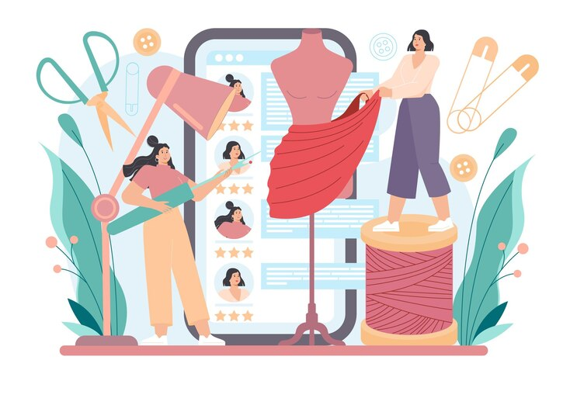
TOPICS
6 Stages of consumer buying behaviour
Consumer behaviour patterns
3 types of consumer behaviour
Digital experiences
Customer journey

Slide 3
6 STAGES OF CONSUMER BUYING PROCESS
Stage 4
Purchase Decision
Stage 1
Need Recognition
Stage 5
Purchase
Stage 2
Information search
Stage 6
Post Purchase Evaluation
Stage 3
Evaluation of Alternative

Slide 4
Simple Decision Making
Stage 4
Purchase Decision
Stage 1
Need Recognition
Step 5
Purchase
Step 6
Post Purchase Evaluation

Slide 5
Stage 1
Need Recognition
No need, no purchase.
Consumer’s need is triggered by internal or external stimuli.
Internal Need | External Need
The temperature drop. I’ll buy a coat. | That dress is very trendy and have discount. I’ll buy it.

Slide 6
Stage 2
Information search
Consumer seeks information that can help make a purchasing decision.
Internal Information | External Information
Already present in the consumer’s memory: How was my experience with this fashion brand last year? | Obtained from other consumers: How do fashion bloggers rate this fashion brand?

Slide 7
Stage 3
Evaluation of Alternative
Consumer evaluates alternatives based on product features, brand perception, and other attributes.
Consumers Consider Different Attributes
This garment is trendy in fashion colour. Perfect for this season. | This garment is basic and fit. Perfect for basic item.

Slide 8
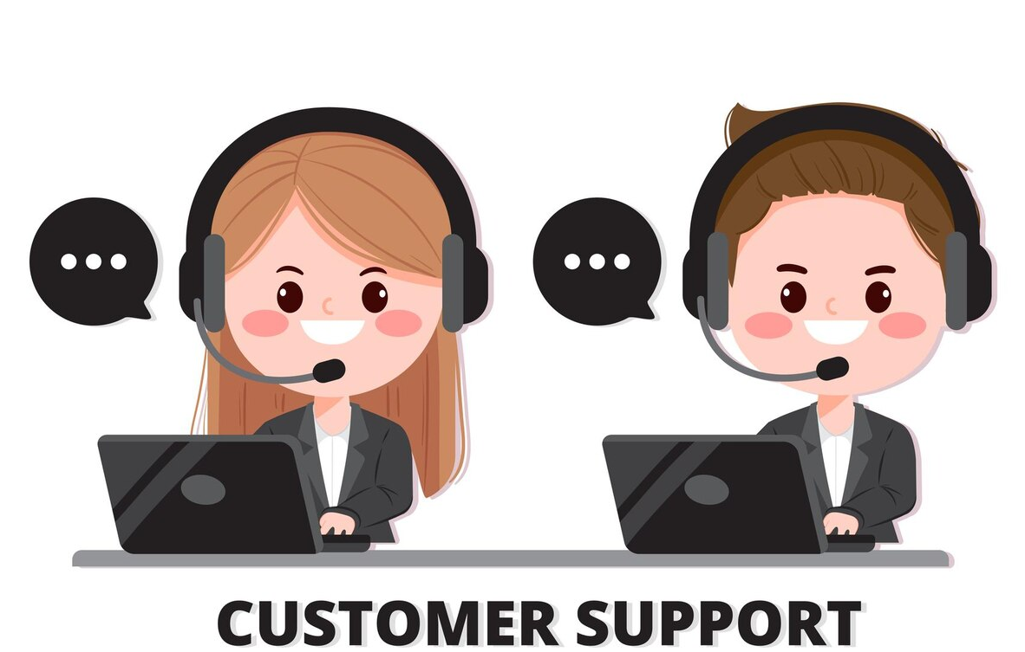
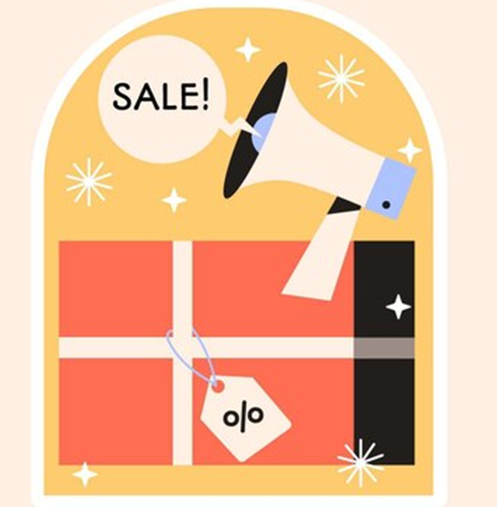
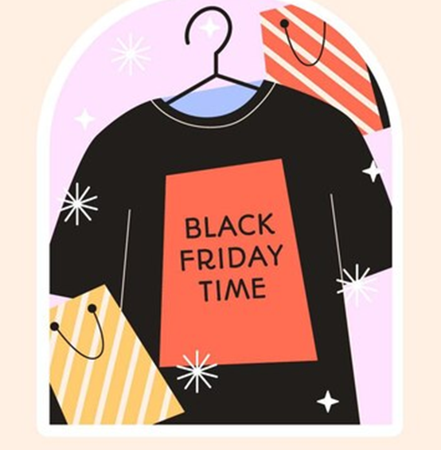
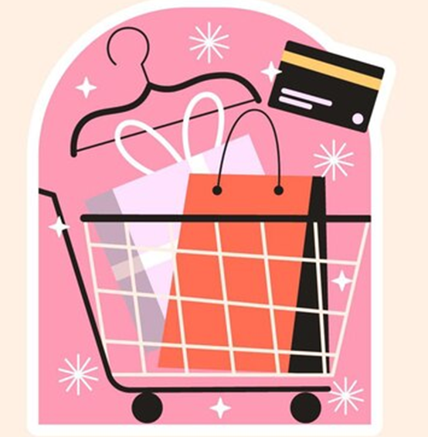
Stage 4
Purchase Decision
Consumer chooses the product that meets the need.
Factors That May Affect Purchase Decision
Customer service
during actual
purchase
Promotions
Shop’s items
and conditions
Website user interface and user experience (for online shopping)

Slide 9
Stage 5
Purchase
Consumer decides when, where and how to purchase.

Slide 10
Stage 6
Post Purchase Evaluation
Consumer determines if he or she made the right purchase.
Satisfied consumers will most likely share their experience and become loyal customers.
“A customer talking about their experience with you is worth ten times that which you write or say about yourself.” – David J. Greer

Slide 11
Personal:
Age
Occupation
Education
Culture:
Social status
Social class
Subculture
CONSUMER
EXPERIENCE
CONSUMER
Psychological:
Motivation
Perception
Beliefs and attitudes
Customers’ Response:
Selecting brand
Buying time
Repurchasing
Buying intervals
CONSUMER
BEHAVIOUR
PATTERNS
CONSUMER
BEHAVIOUR
Environment:
Technology
Economics
Inflation
Politics
Social:
Reference groups
Social roles
Status
Household type
Marketing:
Strategies
Promotions
Advertising
Communications
Social Media:
Video streaming platform
Weblog
LIFESTYLE
EXPERIENCE

Slide 12
What is the need / importance of studying
CONSUMER BEHAVIOUR?
Comprehending consumer needs
Fabricating effective marketing strategies
Identifying market opportunities
Enhancing customer experience
Minimising risks and failures
Building strong brand relationships
Customers’ Response:
Selecting Brand
Buying time
Repurchasing
Buying intervals
Need /
Importance

Slide 13
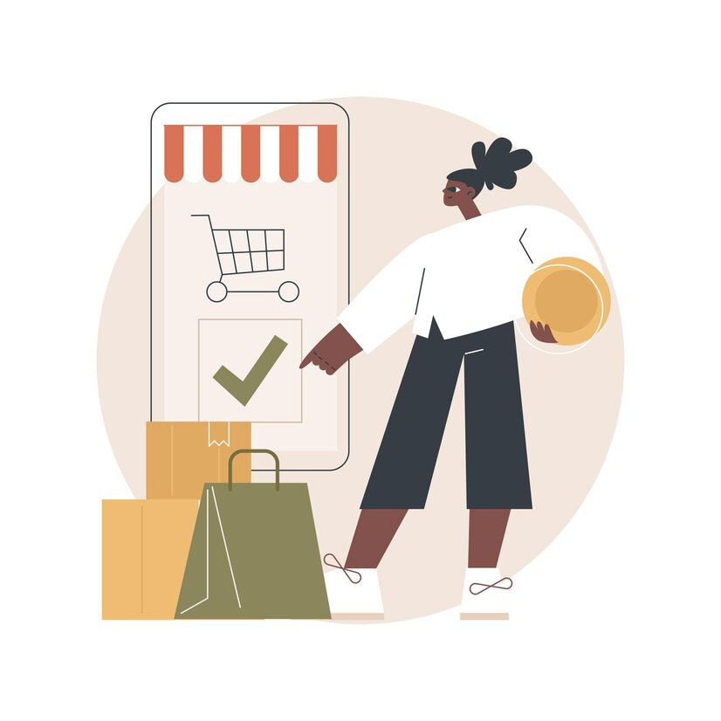
3 Types of Consumer Behaviour
Purchase behaviour: what a consumer is willing to buy.
Demand: the overall level of interest in a product, service, or brand
Retention: how long a consumer continues to use a given brand
Recall: how accurate consumers are when recalling their purchase experiences
Usage behaviour: how the product is used.
Attrition: the percentage of consumers who leave a product or brand due to dissatisfaction, perceived lack of value, or other factors
Consumer loyalty: The extent to which consumers remain loyal to one brand over time.
Post-purchase behaviour: how a consumer feels about the product when they buy it
Pre-purchase behaviour: how a consumer decides which product to buy

Slide 14
10 Top Consumer Trends 2024
Trust in artificial intelligence (AI) remains low despite its widespread use, calling for more transparency.
Social media has transformed into shopping hubs, with influencers playing a big role in buying decisions.
Newer social platforms gain popularity, while established ones see slower growth.
Social search and AI shake up traditional search engines, but people still trust them.
Economic uncertainty prompts tightening budgets and job security worries.
Data privacy becomes a basic right and demands clear rules and control.
Brands standing for social issues and diversity earn consumer loyalty.
Support for small businesses grows as consumers seek community connection.
People prefer human support, social connections, and mobile searches.
Flexible work arrangements become essential and strongly influence job decisions.

Slide 15
Digital Experience

Slide 16
Consumer Experience
Public
Relationship
Word
Of Mouth
Online
Advertisements
Viral
Email
Digital
Billboard
Outdoor Media
Radio
Print
Television
Awareness
Landing
Page
3rd Party
Sites
Direct Mail
Blog
Consideration
Physical Touchpoints
Digital Touchpoints
Store
Call Center
Website
Purchase
Call
Center Interactive
Voice Response
Instant
Messaging /
Chat
Mobile
Service
Promotion on
Invoice
Blog
Email
Newsletter
Loyalty

Slide 17
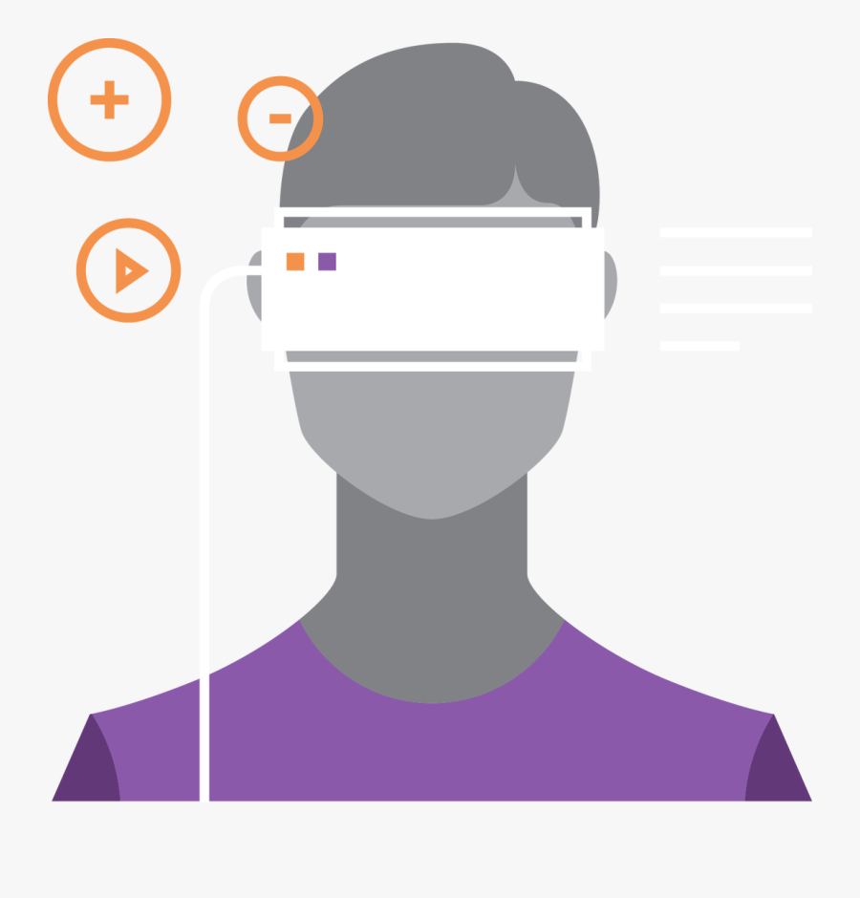
Digital Experience
IoT
(Internet of Things)
Real-time monitoring
Health monitoring
AI
(Artificial
Intelligence )
Prediction
Dress recommendation
Forecast trend
Digitalisation in
Fashion Industry
AR/VR
(Augmented Reality / Virtual Reality)
Product development
Product experience
Blockchain
Supply Chain
Circular economy

Slide 18
Works prepared by student in FHDFASH Higher Diploma in Digital Fashion Creation, Hong Kong Metropolitan University
Example: Digital Fashion Design
IoT
Real-time monitoring
Health monitoring
AR/VR
Product development
Product experience
Blockchain
Supply Chain
Circular economy
Photo(s) is/are provided by the Clothing Industry Training Authority

Slide 19
CUSTOMER JOURNEY
Aspiration
Consideration
Brand Advocate
IoT
Real-time monitoring
Health monitoring
“I need a new outfit for
Joyce’s birthday party.”
“I love this singer’s style and I’d love to find an outfit she would wear.”
“ I found the ideal outfit at a price I am willing to pay.”
This fashion magazine updates me with all the latest styles of my favourite celebrities. I’ll purchase from them again tell my friends about them.
Customer
Mind-set
Witnessing
Digital display
Social media (profiles)
Social media (advertising)
Email (sign up)
Press advertisement (ad)
Pay per click
Search engine optimisation
Press
Partners
Celebrity endorsement
Mobile ad
Researching
Blog (company and affiliate)
Content marketing
Reviews
Social Media
Website
Email (sign up)
Pay per click (PPC)
Search engine optimisation (SEO)
Location maps
Incentives
Purchasing
Web applications / mobile applications (App)
Website
Social (sharing)
PPC (local)
Email (confirmation)
Short message service (SMS) (confirmation)
Location maps
Coupons
Using
Content marketing
Blog
Exclusive events
Celebrity endorsement
Retargeting
Digital display
Email
App (push notification)
PPC
SEO
Social media (ad)
Explore & Consideration
Moment of Sale
Awareness
Loyalty
AR/VR
Product development
Product experience
Becoming Inspired
Blog
Friends
Word of mouth (WOM)
Sharing
Social media (profile)
WOM

Slide 20
References
(Retrieved on Aug 13, 2024)
HubSpot Blog Research, Consumer Trends Report
(https://offers.hubspot.com/)

